Slide 1
CryptoWolf
Student Presentation for Cryptowatch API
Social Media Management AA 2018/2019
Students:
Gabriele Marino
Maria Ausilia Napoli Spatafora
Rosario Scalia

Slide 2
What is Cryptowatch?
Cryptowath is a service that provides real-time cryptocurrency market data, charting and trading services. The real-time data on Cryptowatch is provided directly from cryptocurrency exchanges via their APIs and covers over 700 markets available on 25+ exchanges. The term market refers to a pair listed on an exchange. For example, the trading pair BTC/USD on exchange Kraken is a market.

Slide 3
Market Data Rest API
Cryptowatch offers a general use public market REST API, providing basic information about all markets on our platform.
https://cryptowat.ch/docs/api

Slide 4
Rate limit
The API is rate limited by a CPU allowance, rather than a fixed number of calls per time window. Some API requests take longer to fetch than others, so these cost more allowance.
Each client has an allowance of 8000000000 nanoseconds (8 seconds) of CPU time per hour. The allowance is reset every hour on the hour.

Slide 5
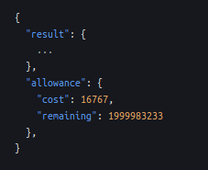
The cost is how many nanoseconds that request took in nanoseconds, and remaining is how many nanoseconds remain in your allowance. You can use this information, along with the current time, to have your application self-regulate its request rate.

Slide 6
Asset
An asset can be a crypto or fiat (currency established as money by government regulation) currency.
Asset Index:
https://api.cryptowat.ch/assets
Returns all assets (in no particular order)
Asset Details:
https://api.cryptowat.ch/assets/btc
Returns a single asset. Lists all markets which have this asset as a base or quote.

Slide 7
Pairs
A pair of assets. Each pair has a base and a quote. For example, btceur has base btc and quote eur.
Pairs Index:
https://api.cryptowat.ch/pairs
Returns all pairs (in no particular order).
Pairs Details:
https://api.cryptowat.ch/pairs/ethbtc
Returns a single pair. Lists all markets for this pair.

Slide 8
Exchanges
Exchanges allow customers to trade cryptocurrencies for other assets (such as fiat money or other cryptocurrencies).
Exchange Index:
https://api.cryptowat.ch/exchanges
Returns a list of all supported exchanges.
Exchange Details:
https://api.cryptowat.ch/exchanges/kraken
Returns a single exchange, with associated routes.

Slide 9
Markets
A market is a pair listed on an exchange. For example, pair btceur on exchange kraken is a market.
Market Index:
https://api.cryptowat.ch/markets
Returns a list of all supported markets.

Slide 10
Market Details:
https://api.cryptowat.ch/markets/coinbase-pro/btcusd
Returns a single market, with associated routes.
Market Price:
https://api.cryptowat.ch/markets/coinbase-pro/btcusd/price
Returns a market's last price.

Slide 11
Market Summary:
https://api.cryptowat.ch/markets/coinbase-pro/btcusd/summary
Returns a market's last price as well as other stats based on a 24-hour sliding window:
High price
Low price
% change
Absolute change
Volume

Slide 12
Parameters supported:
Param | Description | Format | Example
limit | Limit amount of trades returned. Defaults to 50. | Integer | 100
since | Only return trades at or after this time. | UNIX timestamp | 1481663244
Market Trades:
https://api.cryptowat.ch/markets/coinbase-pro/btcusd/trades
Returns a market's most recent trades, incrementing chronologically.
Trades are lists of numbers in this order:
[ ID, Timestamp, Price, Amount ]
Note some exchanges don't provide IDs for public trades.

Slide 13
Parameters supported:
Param | Description | Format | Example
limit | Only return n orders on each side | Integer | 10
depth | Only return orders cumulating up to n size | float | 20,4
span | Only return orders within n% of the midpoint | float | 0,5 (meaning 0.5%, not 50%)
Market Order Book:
https://api.cryptowat.ch/markets/coinbase-pro/btcusd/orderbook
Returns a market's order book (list of open trades).
Orders are lists of numbers in this order:
[ Price, Amount ]

Slide 14
Parameters supported:
Param | Description | Format | Example
before | Only return candles opening before this time | UNIX timestamp | 1481663244
after | Only return candles opening after this time | UNIX timestamp | 1481663244
periods | Only return these time periods | Comma-separated integers | 60,180,108000
Market OHCL:
https://api.cryptowat.ch/markets/coinbase-pro/btcusd/ohlc
Returns a market's OHLC candlestick data (OHLC charts are a type of bar chart that shows open, high, low and closing prices). Returns data as lists of lists of numbers for each time period integer.

Slide 15
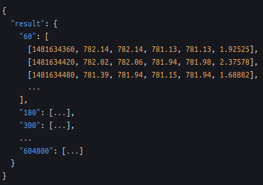
value | label
60 | 1m
180 | 3m
300 | 5m
900 | 15m
1800 | 30m
3600 | 1h
7200 | 2h
14400 | 4h
21600 | 6h
43200 | 12h
86400 | 1d
259200 | 3d
604800 | 1w
All periods supported:
The values are in this order:
[ CloseTime, OpenPrice, HighPrice, LowPrice, ClosePrice, Volume ]

Slide 16
Aggregate Endpoints
You can also retrieve the prices and summaries of all markets on the site in a single request. These responses are cached and may be out of date by a few seconds.
Markets are identified by a slug, which is the exchange name and currency pair concatenated with a colon, like so:
coinbase-pro:btcusd

Slide 17
Prices:
https://api.cryptowat.ch/markets/prices
Returns the current price for all supported markets. Some values may be out of date by a few seconds.
Summaries:
https://api.cryptowat.ch/markets/summaries
Returns the market summary for all supported markets. Some values may be out of date by a few seconds.

Slide 18
Why Cryptowatch?
We have chosen Cryptowatch because of its free API. Actually, we tried other socials failing:
Booking: it requires site with 500 order/month
Google News: it gives only 30 words with free subscription (premium subscription costs $$$)
Reddit: it never answer our request.

Slide 19
Google
Chart

Slide 20
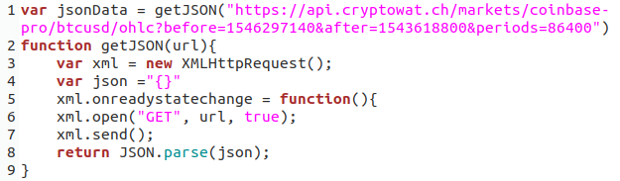
First Step
We have tried to extract json through AJAX, but our request has been blocked by CORS and CORB problem (i.e. browser security sistem).

Slide 21
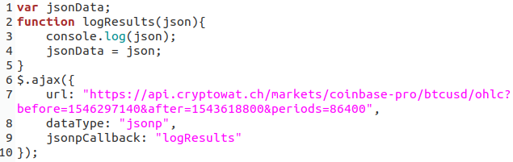
Second Step
We have used JSONP type for AJAX request, but failing in data visualization (and usage).

Slide 22
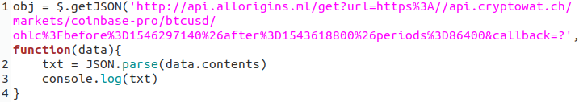
Third Step
http://allorigins.ml/ is the solution to all bad guys!!

Slide 23
Fourth Step
Problems are infinity…
GChart methods accepts only two-dimensional array and it’s OK after several test…
But

Slide 24
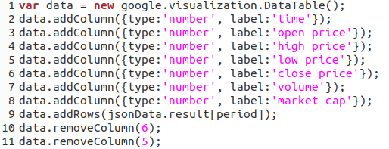
Fitfth Step
We have bypassed the problem creating empty DataTable, populating it and removing the two excess columns

Slide 25
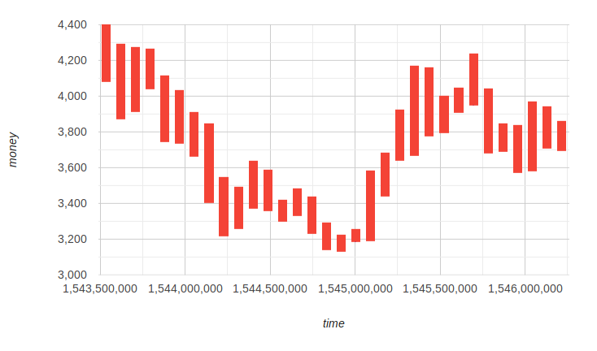

Sixth Step
The visualization problem seemed resolved, but… NO!

Slide 26
Why?
Google Chart accepts array format as [time, low price, open price, close price, high price, [tooltip]]. Our JSON’s format is [time, open price, high price, low price, close price, [volume, market cap]].
We have tried to exchange the columns properties in different ways, but we have failed...

Slide 27
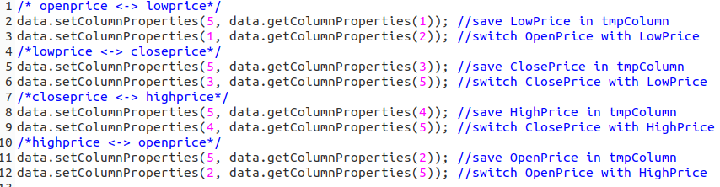
1° way

Slide 28
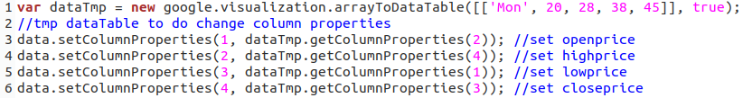
2° way

Slide 29
CryptoWatch
Embed

Slide 30
What is?
CryptoWatch Embed is small library for embedding Cryptowatch charts on a website in real time:
https://github.com/cryptowatch/embed
Few options can be provided to configure the chart:
Exchange and currency pair;
Width and height;
Time Period (it can be set in real time)
Color Scheme.

Slide 31
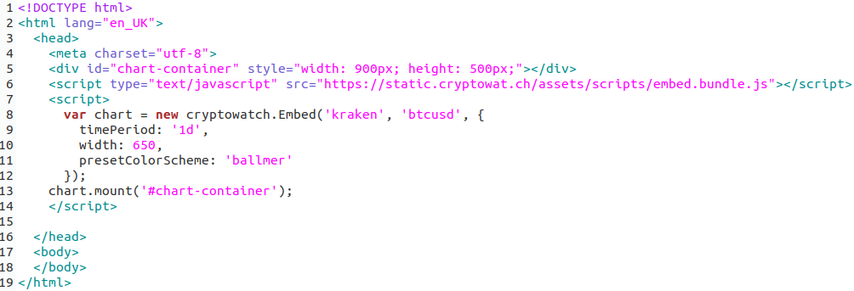

Slide 32
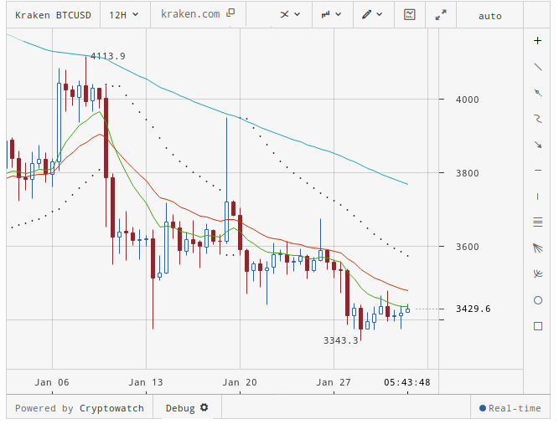
The libraries renders the candlestick chart with volume underneath.

Slide 33
Index.py class

Slide 34
What is?
We have used several instruments to describe distribution shape, central tendencies and dispersion indices computed in Index class.
After extracting data, this is converted in numpy array to perform computation; data are 12-hour candle from 01-01-2011, 00:00 to 04-02-2019, 01:00 previously saved in a .pkl file by Dataset_Creator. The data are Open Price’s vector and Close Price’s vector.

Slide 35
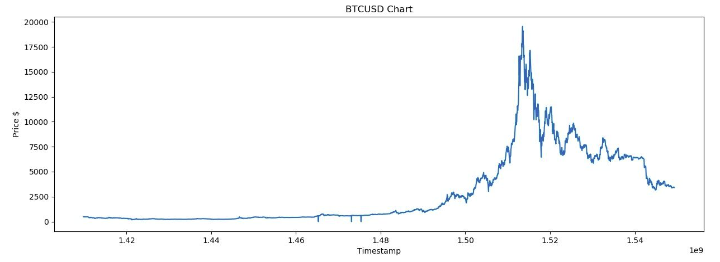
Data visualization
Firstly, we have plotted close time VS close price to check if our data are correct:
But we have realized that some candles are dirty because of API Cryptowatch: they have close price setted to 0.0.

Slide 36
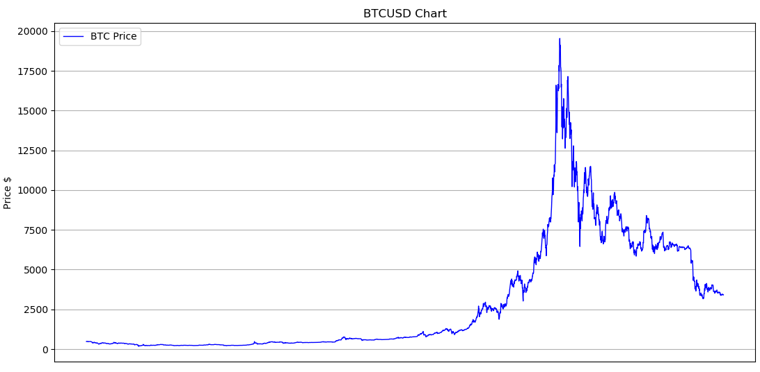
So, we have created the new dataset removing this dirty candles and we have plotted again:

Slide 37
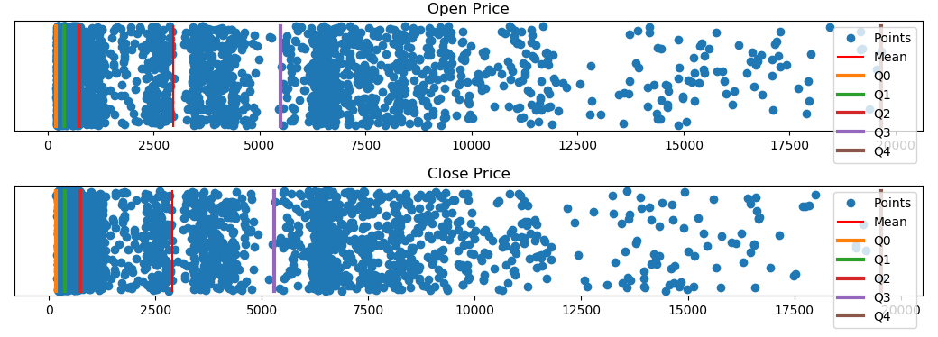
It is used dotplot to show data marked mean and quartiles (0%, 25%, 50%, 75%, 100%).
Mean and median are in according to dotplot’s density.

Slide 38
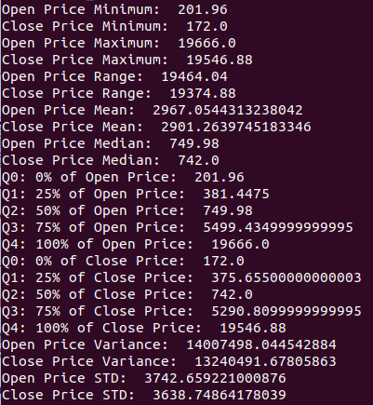
The figure shows all descriptive indices calculated:
Minimum, maximum and range
Mean and Median
Quartiles (0%, 25%, 50%, 75%, 100%)
Variance
Standard Deviation

Slide 39
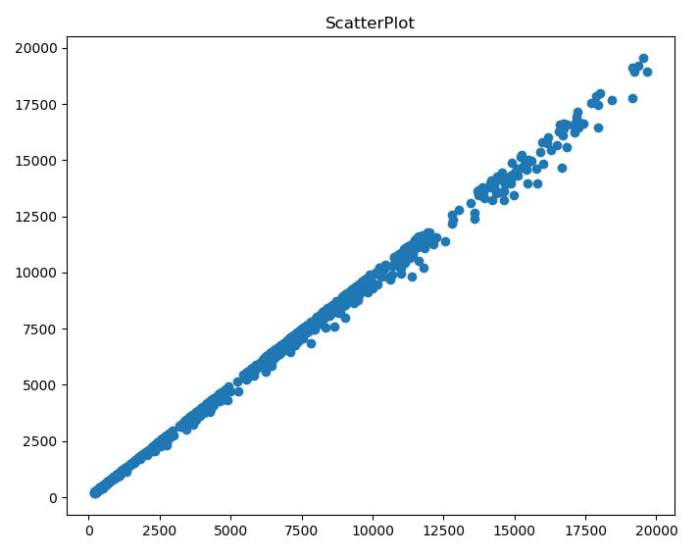
To measure correllation between data series is done the Scatter plot: data are aligned along a straight line.
The covariance is computed through the covariance matrix which reports:
Cov(X,X) and Cov(X,Y) on first row;
Cov(Y,X) and Cov(YY) on second row.
The main diagonal contains the variance of two data series; the other diagonal contains the covariance: this value is positive and so the characters grow each other.

Slide 40
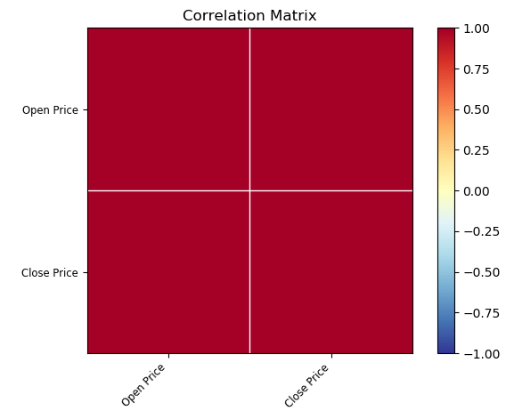
Other correlation coefficients are:
Pearson: its values is almost 1 and so implies an exact linear relationship (0.9994577431432222);
Spearman rank-order: its values is almost 1 and so implies an exact monotonic relationship (0.9996041721721992);
Kendall: its values is almost 1 and so implies strong agreement (0.9874331459000218);
Matrix correlation: it can be observed strong correlation between data series, again.

